Slide 1
Machine Learning Case Study
M Ruthvik Reddy
CB.SC.P2AIE25013

Slide 2
Contents:
K-Nearest Neighbors
Regression
a. Linear Regression
b. Lasso Regression
c. Ridge Regression
Vibe Coding
Psephology

Slide 3
K-Nearest Neighbors
K-Nearest Neighbors (KNN) is a non-parametric, supervised learning algorithm that predicts a label or value for a new point by looking at the labels/values of its k closest training examples and aggregating them (majority vote for classification, mean for regression)
Store the labeled training data; there is no explicit model fitted, which is why KNN is often called a lazy, instance-based learner.
Define a distance metric (Euclidean Distance, Manhattan Distance, or Minkowski distance) and, for a query point, find its k nearest neighbors under that metric.
For classification, assign the class by plurality/majority vote of those neighbors; for regression, predict the average of their target values.

Slide 4
K-Nearest Neighbors
Dataset and Processing: In this case study for KNN Cancer Dataset was used, after removing unnecessary features, the features are:
['diagnosis', 'radius_mean', 'texture_mean', 'perimeter_mean', 'area_mean', 'smoothness_mean', 'compactness_mean', 'concavity_mean', 'concave points_mean', 'symmetry_mean','fractal_dimension_mean', 'radius_se', 'texture_se', 'perimeter_se', 'area_se', 'smoothness_se', 'compactness_se', 'concavity_se', 'concave points_se', 'symmetry_se','fractal_dimension_se', 'radius_worst', 'texture_worst','perimeter_worst', 'area_worst', 'smoothness_worst', 'compactness_worst', 'concavity_worst', 'concave points_worst','symmetry_worst', 'fractal_dimension_worst']

Slide 5
K-Nearest Neighbors
Now Considering y as 'diagnosis' and other features as X, then split them into X_train, X_val, y_train, y_val, in this 95% of data was considered for training and other 5% was considered for validation (or testing).
Before doing KNN, find the best possible K value :
error_rates = [] k_values = range(1, 21) # Test k from 1 to 20 for k in k_values: knn = KNeighborsClassifier(n_neighbors=k, metric="euclidean") knn.fit(X_train, y_train) y_pred = knn.predict(X_val) error_rates.append(1 - accuracy_score(y_val, y_pred)) min_error = min(error_rates)
optimal_k = k_values[error_rates.index(min_error)] print(f"Optimal K: {optimal_k} with Minimum Error Rate: {min_error:.4f}")

Slide 6
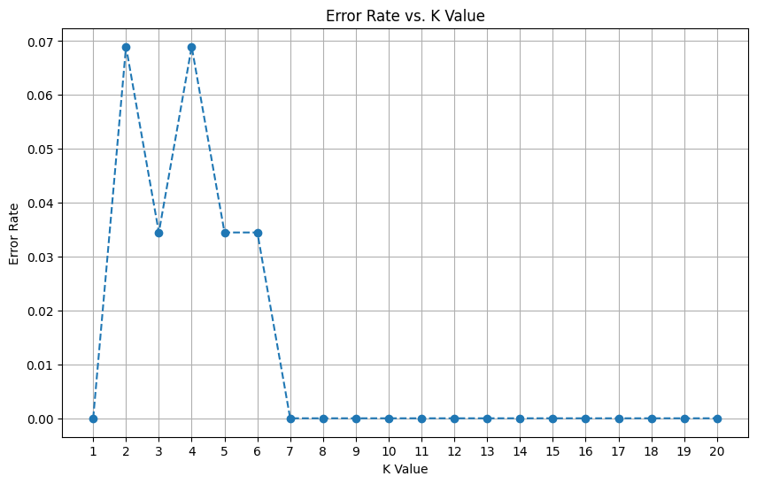
K-Nearest Neighbors

Slide 7
K-Nearest Neighbors
The data was tested with KNN with three different distance metrics: Euclidean Distance, Manhattan Distance, Cosine Distance. And here are the classification report (same for all) for these different distances:
precision recall f1-score support 0 1.00 1.00 1.00 6 1 1.00 1.00 1.00 23 accuracy 1.00 29 macro avg 1.00 1.00 1.00 29 weighted avg 1.00 1.00 1.00 29

Slide 8
K-Nearest Neighbors
Conclusion:
So, for every distance metric used, inferred the same outcome, and every KNN model predicted correct outcomes with 100% accuracy (based on the classification reports).
And the best K value was found with iterating over with all possible K values, which provided the best K value with the least error rate.

Slide 9
Regression
Regression is a type of supervised learning (in machine learning) and a statistical method (in statistics) used to model and analyze the relationship between one dependent variable (target) and one or more independent variables (features). The goal of regression is to predict continuous numerical values.
The dependent variable (Y) is what we want to predict. The independent variables (X) are the inputs/features that influence Y. And the mapping function given as:
Y≈f(X)+ϵ

Slide 10
Regression
Dataset and processing: In this case study, Advertising Dataset was used. This dataset describes about how advertising in TV, Radio, Newspaper impacted the Sales. And the features in the dataset are:
['TV', 'Radio', 'Newspaper', 'Sales']
'Sales' is the dependent feature, and others ['TV', 'Radio', 'Newspaper'] are the independent features.
The data is normalized using sklearn.preprocessing.MinMaxScaler(), where it scales down the data in [0, 1] range, as this is efficient process.
Split the data into X_train, X_val, y_train, y_val, in this 85% of data was considered for training and other 15% was considered for validation (or testing).

Slide 11
Linear Regression
Linear Regression is a supervised learning algorithm used to model the relationship between a dependent variable (Y) and one or more independent variables (X) by fitting a straight line (or hyperplane).
Y=β0​+β1​X1​+β2​X2​+⋯+βn​Xn​+ϵ
To perform Linear Regression, sklearn.linear_model.LinearRegression() was used.

Slide 12
Linear Regression
Fitting data and predicting values:
LinearRegressionV1 = LinearRegression().fit(X_train, y_train) y_perd = LinearRegressionV1.predict(X_val) Y_perd array([[0.27135673], [0.55888557], [0.2409764 ], [0.50745078], [0.60851327], [0.91680504], [0.77621641], [0.51592903], [0.72178291], ........ [0.65064665]])

Slide 13
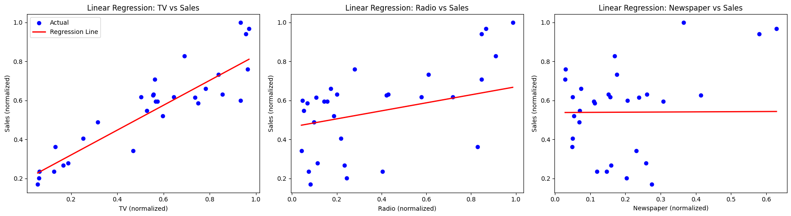
Linear Regression
mse, r2 = (0.004435455043519201, 0.9100791189160852)
Plot for projection line:

Slide 14
b. Lasso Regression (L1 Norm)
Lasso (Least Absolute Shrinkage and Selection Operator) Regression adds a penalty term on the sum of absolute coefficients.
For Lasso Regression, we are using same dataset and same features as the linear regression.
And to perform sklearn.linear_models.Lasso is used.
But before doing Lasso regression, best alpha value should be found, which decides the best regularization rate.
And to that sklearn.linear_models.LassoCV is used

Slide 15
b. Lasso Regression (L1 Norm)
from sklearn.linear_model import LassoCV
LassoCV = LassoCV(alphas=[0.01, 0.1, 1, 10], cv=5, random_state=0)
LassoCV.fit(X_train, y_train)
LassoCV.alpha_
np.float64(0.01)
Now to perform Lasso Regression with alpha=0.01:
from sklearn.linear_model import Lasso
LassoV1 = Lasso(alpha=0.01, random_state=42)
LassoV1.fit(X_train, y_train)

Slide 16
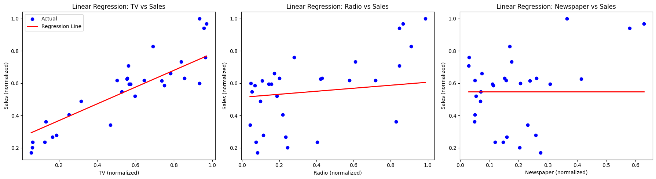
b. Lasso Regression (L1 Norm)
mse, r2 = (0.007454552537285793, 0.848872342147059)
Plot for projection line:

Slide 17
c. Ridge Regression (L2 Norm)
Ridge Regression is a regularized version of Linear Regression that adds a penalty term on the sum of squared coefficients to prevent overfitting.
For Ridge Regression, we are using same dataset and same features as the linear regression.
And to perform sklearn.linear_models.Ridge is used, and same regularization rate as Lasso Regression is used.
from sklearn.linear_model import Ridge RidgeV1 = Ridge(alpha=0.01, random_state=42) RidgeV1.fit(X_train, y_train) y_pred = RidgeV1.predict(X_val) y_pred

Slide 18
c. Ridge Regression (L2 Norm)
mse, r2 = (0.004434287872727083, 0.9101027812066445)
Plot for projection line:

Slide 19
Regression
Conclusion:
Ridge Regression performed well, and following with Linear Regression and Lasso Regression.
The Lasso and Ridge change the learning based on the alpha value, so each has its own best alpha value. But all the projections were similar (close).

Slide 20
Vibe Coding
Definition: AI-assisted coding style using natural language prompts and LLMs to generate code.
Reduces repetitive or boilerplate programming tasks, saving time and improving workflow.
Rapid prototyping, experimentation, and accessibility for both beginners and experienced developers.
How it Works: Describe functionality in plain language → AI generates code → iterative refinement.
Applications: Automated plotting with Matplotlib and data cleaning with Pandas.
Speeds up development, improves efficiency, and allows focus on model building and analysis.

Slide 21
Psephology & Machine Learning
Definition: Scientific study of elections, voting trends, and electoral behavior; specialists are called psephologists.
Origin: From Greek psēphos (“pebble”), reflecting ancient voting methods.
Role of Psephologists: Analyze demographics, polls, historical data, and election systems to understand and predict voter behavior.
Election Outcome Prediction: ML models (Random Forests, Gradient Boosting, Neural Networks) forecast winners using historical and demographic data.
Voter Behavior Analysis: Clustering algorithms segment voters to identify swing populations and support patterns.
Polling & Fraud Detection: ML corrects survey biases, fills missing data, and detects anomalies or irregularities to ensure election integrity.

Slide 22
Thank You

